Slide 1

Machine Learning in Compiler Optimization
Design & Analysis of Algorithm
K19 0305
K19 0175

Slide 2
Overview
Motivation
System Overview
Experiments and Results
Related Work
Conclusions
Future Work

Slide 3

Purpose
investigate and explore how machine learning can find and predict the optimized compiler alternatives for executable programs
Notes:
Notes to presenter:
What is your purpose for sharing this reflection?
Is it at the end of a unit or project?
Are you sharing this reflection, at the attainment of a learning goal you set for yourself?
Is it at the end of a course?
State your purpose for the reflection or even the purpose of the learning experience or learning goal. Be clear and be specific in stating your purpose.

Slide 4
To inspect existing literature on different approaches for compiler optimization and their shortcomings.
To analyze the role of machine learning for compiler optimization.
To discuss the machine learning algorithms and models and types of learning methods with their featured engineering methods to find the optimum solution for the problem.
Objectives

Slide 5

New program
Compiler
Unroll
Executable
Inline
Peephole
few seconds
DCE
Unroll
Unroll
Solution
Unroll
Unroll
Unroll
Fast
Execution
Optimization 100

Slide 6

process
Prepare
extract features
modify heuristic values
choose transformations
find hot methods
Gather Training Data
01
04
02
Deploy
Compiler
set heuristic values
03
Learn
Notes:
Notes to presenter:
What did you think at first?
What obstacles did you encounter along the way?
How did you overcome those obstacles?
What images can you add to support your process?
This SmartArt allows you add images and text to help outline your process. If a picture is worth a thousand words, then pictures and words should help you communicate this reflection on learning perfectly! You can always click on Insert>SmartArt to change this graphic or select the graphic and click on the Design contextual menu to change the colors.
Feel free to use more than one slide to reflect upon your process. It also helps to add some video of your process.

Slide 7
Zheng Wang and Michael O'Boyle divide the problem into two main stages, i.e. learning and deployment
learning model is based on the seen data through models by (Wang, Z. and O’Boyle, M., 2018).
IEEE's article Machine Learning in compiler optimization explains the importance of feature engineering for extracting static data structures extracted from the compiler's intermediate representation and dynamic profiling.
J. Ansel, Y. L. Wong in 2011 explains the learning stage where it generates its training data using transfer learning
Compiler developer will select training programs for the teaching (J.Ansel, M.K., 2017).
Literature Review

Slide 8
Deployment
Online phase, for every function:
Calculate the feature vector
Compute the prediction
Use this prediction as heuristic context
Overhead is negligible

Slide 9
Data Preparation
Three key elements:
Feature extraction
Heuristic values modification
Target set of transformations
Existing XL compiler is missing functionality
Extension was made to the existing Heuristic Context approach
Unroll
Wand waving
If-conversion
Un switching
CSE
Index Splitting ….
Total # of insts
Loop nest level
# and % of Loads, Stores, Branches
Loop characteristics
Float and Integer # and %

Slide 10
Gathering data for training
Try to “cut” transformation backwards (from last to first)
Late In lining
Unroll
Wand waving
If run time not worse than before, transformation can be skipped
Otherwise we keep it
We do this for every hot function of every test
The main benefit is linear complexity.

Slide 11
Methods
Iterative Compilation
revisiting the structure and interactions of compilers and building on the empirical knowledge accumulated from previous iterative optimization prototypes.
Heuristic Tuning
methodology for automatically fine-tuning compiler heuristics using machine-learning techniques

Slide 12
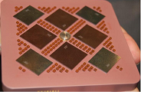
Experiments
Benchmarks:
SPEC2000
Others from IBM customers
Platform:
IBM server, 4 x Power5
1.9 GHz, 32GB RAM
Running AIX 5.3

Slide 13
Learning with Logistic Regression
Function
Descriptions
Input
Classifier
Best Heuristic Values
Logistic Regression
Neural Networks
Genetic Programming
Compiler
&
Heuristic Values
.hpredict
files
Output

Slide 14
Machine Learning Models Deployed
Genetic Algorithm: heuristic searching where the fittest ones are selected.
Supervised Algorithms: providing road map for the wide variety of different areas.
Unsupervised Algorithms: Unlike supervised models which learn a correlation from the input
values it uses clustering technique.
Clustering: An extension of unsupervised learning making a collections of similar data.
Regression Models: A technique of analyzing dependent and independent data to form a relationship.
K-Means: an extension of unsupervised learning algorithm using clustering to categorize data into groups.

Slide 15
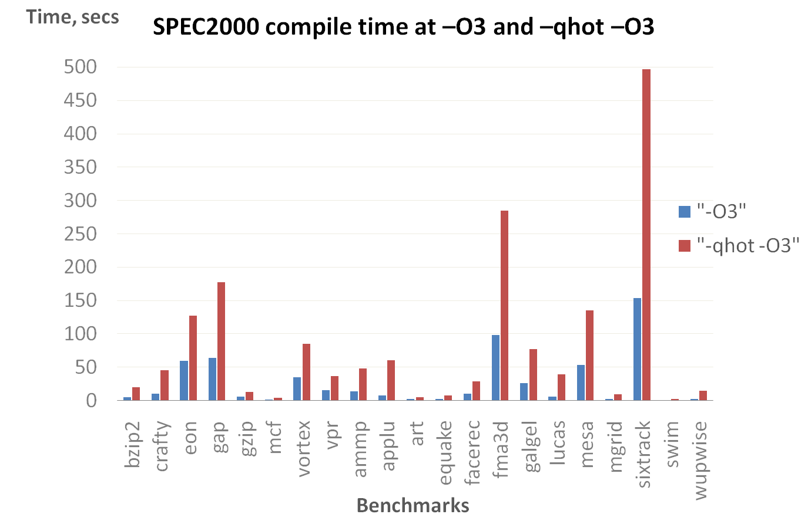
Initial Experiment

Slide 16
Initial Experiment 1.1

Slide 17
Result: Execution time

Slide 18
Result: Compilation time

Slide 19
New benchmarks: Compilation time

Slide 20
New benchmarks: Execution time

Slide 21
Approach | Problem | Application Domains | Model
Supervised learning | Regression | Useful for modelling continuous values, such as estimating execution time, speedup, power consumption, latency etc | Linear/non-linear regression, artificial neural networks (ANNs), support vector machines (SVMs).
 |  |  | K-nearest neighbor (KNN), decision trees, random forests, logical regression, SVM, Kernel Canonical Correlation Analysis, Bayesian
 | Classification | Useful for predicting discrete values, such as choosing compiler flags, #threads, loop unroll factors, algorithmic implementations etc.
Unsupervised learning | Clustering | Data analysis, such as grouping profiling traces into clusters of similar behavior. | K-means, Fast Newman clustering
 | Feature Engineering
 |  |  | Principal component analysis(PCA), auto encoders,Genetic Algorithm.
 |  | Feature dimension reduction, finding useful feature representations

Slide 22

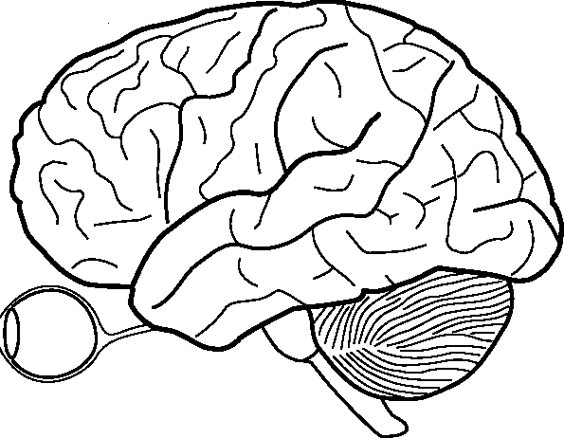
What did you learn?
unlike other machine learning models, it generates its training data using transfer learning and compiler developer will select training programs for the teaching.
The developer compiles using multiple optimization options, tunes the compiled binaries to analyze the best running time and then feed into the algorithm accordingly.
Unroll
Unroll
Optimization 100
Notes:
Notes to presenter:
Description of what you learned in your own words on one side.
Include information about the topic
Details about the topic will also be helpful here.
Tell the story of your learning experience. Just like a story there should always be a beginning, middle and an end.
On the other side, you can add a graphic that provides evidence of what you learned.
Feel free to use more than one slide to reflect upon your process. It also helps to add some video of your process.

Slide 23

Conclusions and Future Work
2x average compile time decrease
4
3
Execution time improvement
Performance Counters for better method description
2
1
O5 level
Heuristic Context Infrastructure
Bug Finding
Notes:
Notes to presenter:
What steps will you be taking as a result of this learning experience?
Did you learn from any failed experiences? How will you do things differently?
What advice will you give to others so they can learn from your experiences?
How can you share what you learned with a real-world audience?
Some examples of next steps might be:
After delivering my first persuasive presentation, I am thinking about joining the debate team.
After making my first film, I’m considering entering it in our school film festival or local film festival.
After connecting with this career expert, I’d like to do some research on that career field because it sounds interesting to me.
This SmartArt allows you add images and text to help outline your process. If a picture is worth a thousand words, then pictures and words should help you communicate this reflection on learning perfectly! You can always click on Insert>SmartArt to change this graphic or select the graphic and click on the Design contextual menu to change the colors.
Feel free to use more than one slide to share your next steps. It also helps to add some video content to explain your message.

Slide 24
End
THANK YOU!!

